Slide 1



EDA Project on Used Cars in Market–Data
Submitted by :-
Pankaj Kumar (July Cohort)

Slide 2

Preface: Used Car Market Analysis
Main objective of this project is to draw insights into used car available in market.
Also to perform EDA on the dataset to get detailed insights about the sample data.
-----------------------------------------------------------------
Data is from a dealer which provides price quotes for the cars put up for sale.

Slide 3
Data Set - Information
Data is used from github from insaid2018 term1. it’s a sample data of 10000 used cars available for sales.
Below are the features of the data set used for easy understanding:
Sample data

Slide 4
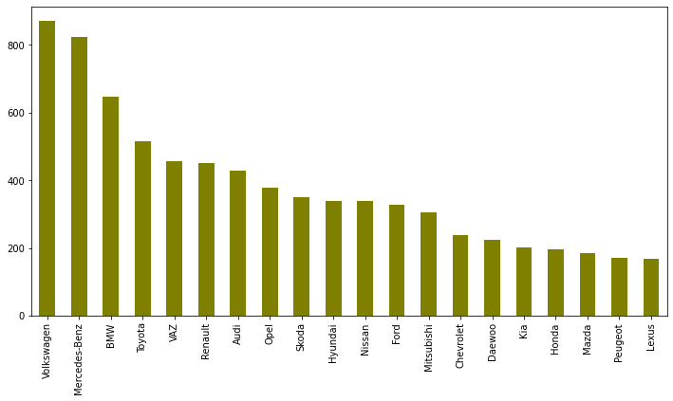
Used Cars –Brand Overview
Highest availability of Volkswagen cars in used car market.
Mercedes Benz is second most sought after cars in used car segment.
Top 20 cars make selected for above graph.

Slide 5
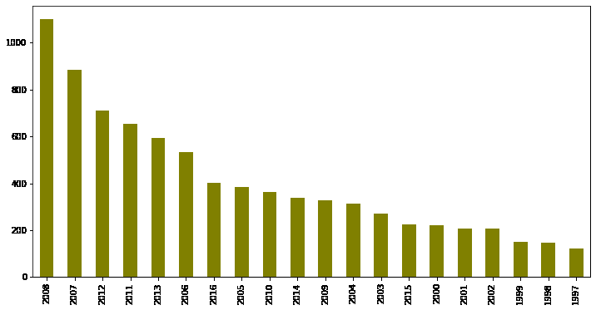
Used Cars –Make Years Overview
Highest availability of 2008 make cars available in used car market.
Top 20 make years car data selected for this graph.
Year 2008 make used cars is roughly 12% of overall used cars available.

Slide 6
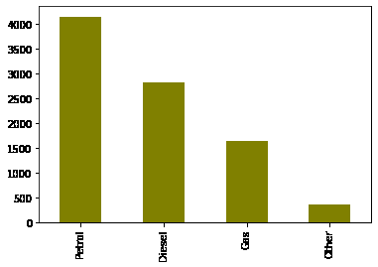
Used Cars – Fuel Type Overview
Contribution %
----------------------------
Petrol 46.28
Diesel 31.47
Gas 18.36
Other 3.87
Petrol driven cars are in demand as per market availability with stockist.
46% of used cars available has Petrol as fuel type.
Other is still not significant in the used car market.

Slide 7
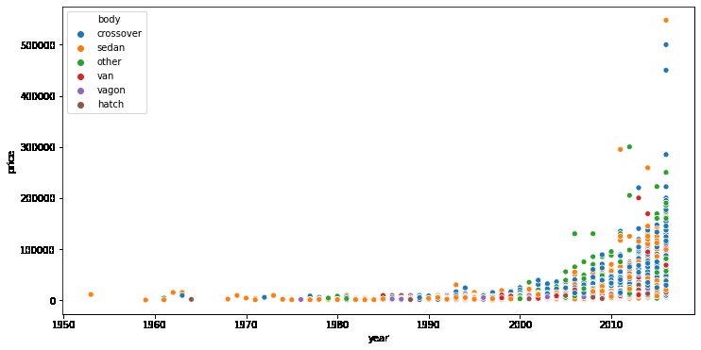
Body Type & Year Wise Overview
Sedan is the most sought after body type used car in market.
Hue in the chart shows body type vis a vis year make cars available in the market.

Slide 8
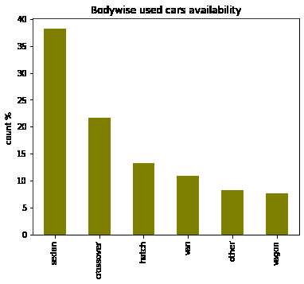
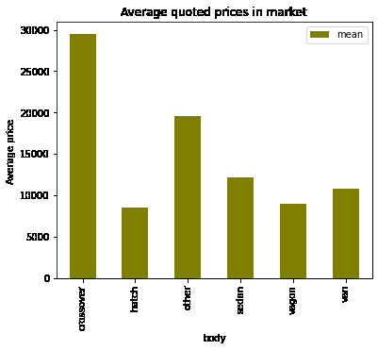
Body Type & Price Quoted
Sedan is the most sought after body type used car in market.
However crossovers are sold at higher price points.

Slide 9
Feature - Relationships
 | price | mileage | engV | year
price | 1.000000 | -0.254342 | 0.060403 | 0.384459
mileage | -0.254342 | 1.000000 | 0.043678 | -0.457680
engV | 0.060403 | 0.043678 | 1.000000 | -0.036536
year | 0.384459 | -0.457680 | -0.036536 | 1.000000
Here we tried to check correlation status amongst features available.
Price of used car and make of used car has a mild positive correlation meaning older year make cars are also in high price band and make year is not the only determinant of the price.
Mileage to Price is mildly inverse related in determining used car prices.

Slide 10

Conclusion
As per sample data ,prices in the used car market is not only dependent on the features as per correlation matrix and can be safely assumed condition of the car is also one of the factors.
Sedans are more sought after by buyers in used car segment as per the sample data.
Prices quoted for the cross-overs is more and sellers would benefit if they increase their sales volume.
Other fuel types namely EV’s still majorly available in market .

